Slide 1
Use Case Analysis

Slide 2
Introduction
used to explain and document the interaction that is required between the user and the system to accomplish the user’s task
a key aspect of determining the requirements for the new system is understanding the user requirements:
the things the users need to accomplish with the new system
Use cases help us understand and clarify the users’ required interactions with the system
Use cases can reveal most, if not all, functional requirements of the new system.

Slide 3
Why we need use cases
users may not know what is and is not possible for the system to do
Users are not likely to truly understand the capabilities and limitations of information systems technologies
especially new advances in technology
users may have difficulty envisioning new ways to redesign business processes
we are so accustomed to things being done the “old way.”
users often found it difficult to learn the process and data modeling languages used by the analysts

Slide 4
Why we need use cases
in any development approach (waterfall, RAD, or agile) we need to hear and understand what the user needs to accomplish with the system.
Use cases are especially valuable in that systems commonly involve extensive user interactions
A use case represents how a system interacts with its environment by illustrating the activities that are performed by the users of the system and the system’s responses.
Use cases showing how the users view the process
use cases describe the system’s activities from the user’s perspective in words

Slide 5
Benefits
the use cases will reveal considerable detail about the functional requirements of the new system
use cases are very helpful in understanding exceptions, special cases, and error handling requirements in the new system
the text-based use case is easy for the users to understand, but it also flows easily into the creation of process models and the data model

Slide 6
Use Cases
Each use case describes how an external user triggers an event to which the system must respond
Use case may be simple or complex
Simple use cases may have only one path through them, while
complex use cases may have several possible paths.
We create use cases when they are likely to help us better understand the situation and help convey the required user-system interactions
For very simple processes that are well explained in the requirements definition, we often do not need to create a use case.

Slide 7
Use Cases
It is important to create use cases whenever we are reengineering processes or making any changes to business processes that will significantly alter the way people work
it is critical to involve the user in the creation of the use case so that the user understands the interactions planned for the new system.
Creation of use cases is often done as a part of interview sessions with users and as a part of JAD sessions
Users work closely with the project team to create the use cases

Slide 8
Elements of a Use Case
1- Basic Information
name should be as simple, yet descriptive, as possible
number is simply a sequential number that serves to reference each use case
The description briefly conveys the use case’s purpose
priority may be assigned to indicate the relative significance of the use case in the overall system
actor refers a person, another software system, or a hardware device that interacts with the system to achieve a useful goal
trigger for the use case: the event that causes the use case to begin

Slide 9
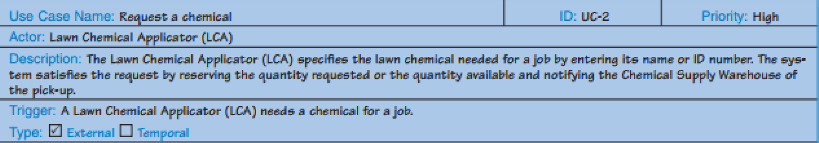
Elements of a Use Case

Slide 10
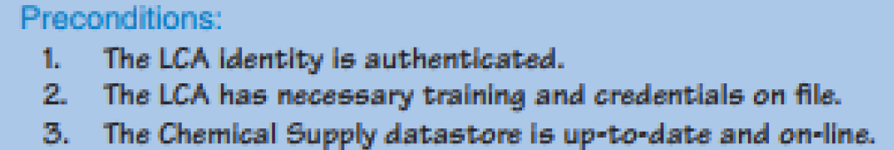
Elements of a Use Case
2- Preconditions: what needs to be accomplished before each use case begins
it is common practice to create smaller, more focused use cases breaking the whole process down into parts.
These preconditions define the state the system must be in before the use case commences.

Slide 11
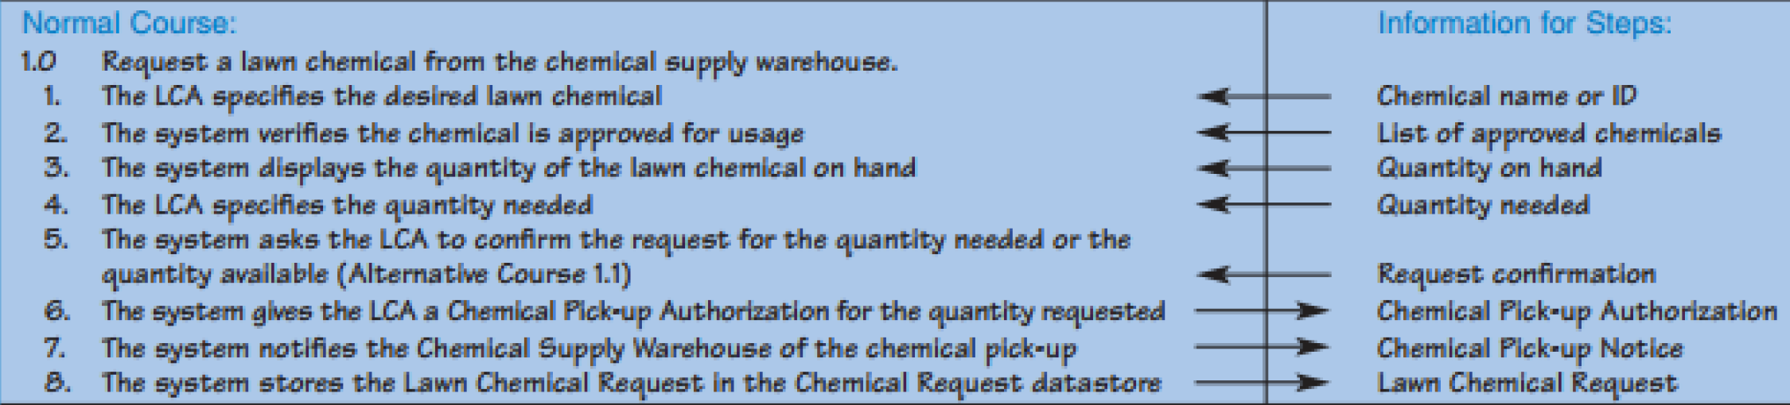
Elements of a Use Case
3- Normal Course (the “happy path”): description of
the major steps that are performed to execute the response to the event
the inputs used for the steps, and
the outputs produced by the steps

Slide 12
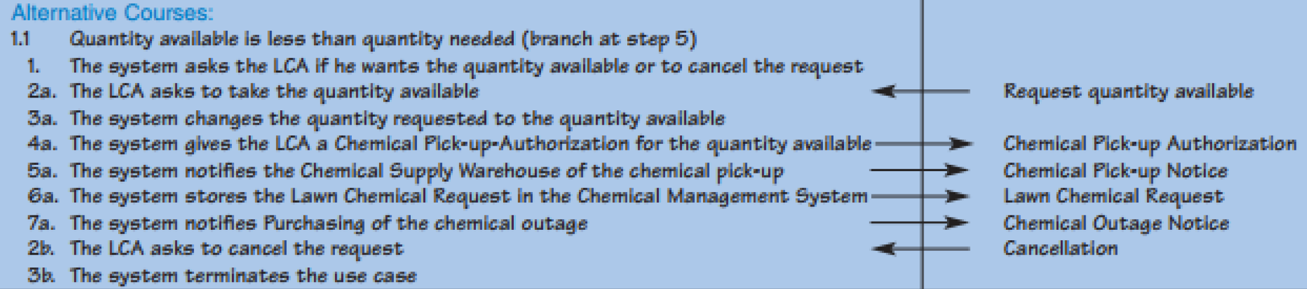
Elements of a Use Case
4- Alternative Courses
steps followed for alternative paths through the use case are outlined.

Slide 13
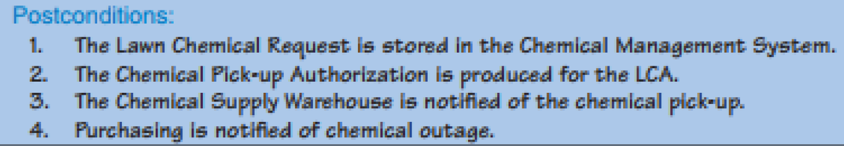
Elements of a Use Case
5- Postconditions:
define the final products of this use case
These postconditions also serve to define the preconditions for the next use case in the series.

Slide 14
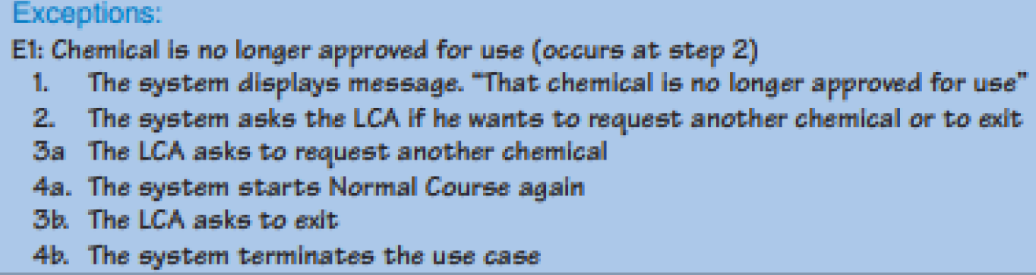
Elements of a Use Case
6- Exceptions: a use case should describe any error conditions or exceptions that may occur as the use case steps are performed
unusual occurrences or errors that could potentially be encountered and will lead to an unsuccessful result

Slide 15
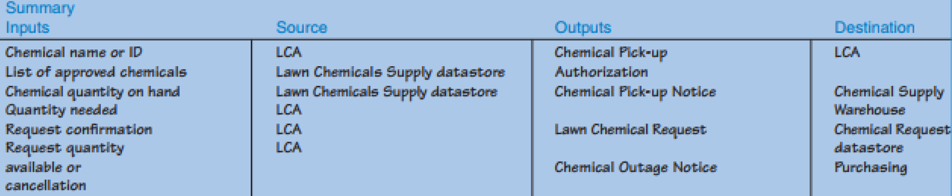
Elements of a Use Case
7- Summary Inputs and Outputs
summarizes the set of major inputs and outputs to the steps of the use case

Slide 16
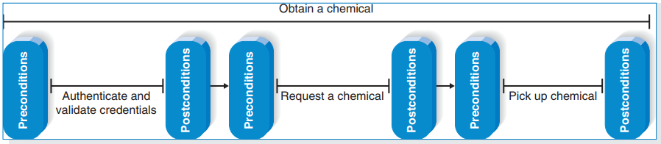
Elements of a Use Case
System are usually a series of use cases

Slide 17
Notes
it takes considerable practice to write use cases well
You should not realistically expect to create a perfect use case on the first try
process of building use cases is one of gradual refinement
As you gain experience, the creation of use cases will become more intuitive.
there should be at least
one person who has a programming perspective
another person who has deep knowledge of the business rules
another person who is thoroughly familiar with how the system will actually be used.

Slide 18
Use Cases and the Functional Requirements
Use cases do explain the user’s interaction with the system, but they omit a lot of details that are necessary to know before the system can be developed.
Transforming the user’s view into the developer’s view by creating functional requirements is one of the important contributions that the systems analyst makes to the development project

Slide 19
Use Cases and Testing
By studying the use cases and the functional requirements derived from them, the testing personnel can readily identify elements of the tests they will want to perform when the system enters testing.
When it comes time to actually perform the tests, the testing personnel are well prepared and not forced to develop and perform the tests in a rush

Slide 20
Building Use Cases
Use cases can be used for both the as-is and the to-be systems;
as-is use cases focus on the current system,
whereas to-be use cases focus on the desired new system
After the use cases have been built, analysts often return to the requirements definition and revise it according to their improved understanding of the system.
The most common ways to gather information for the use cases are interviews and JAD sessions
Observation also is sometimes used for as-is use cases.

Slide 21
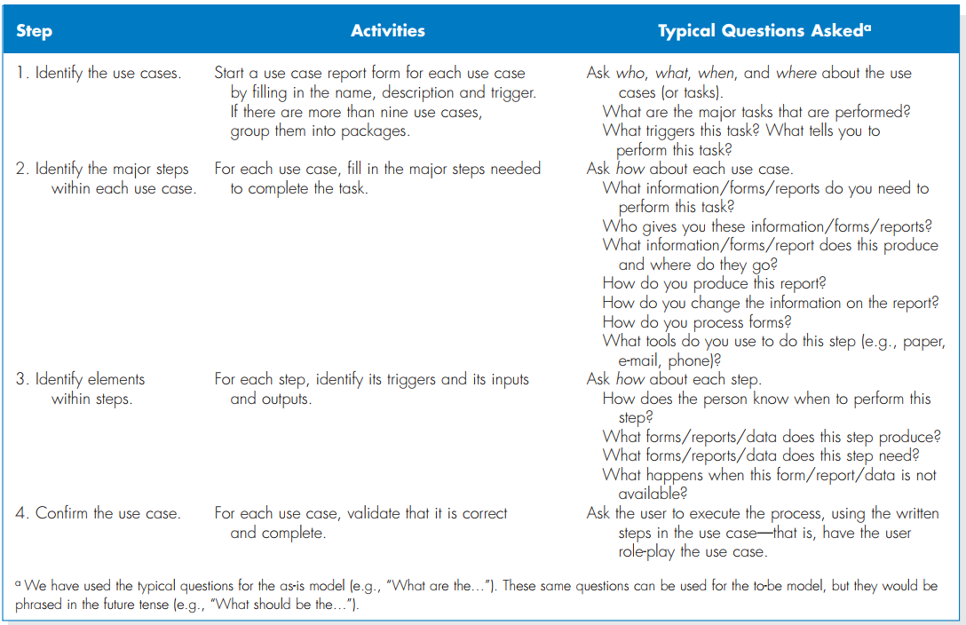
Building Use Cases

